Slide 1
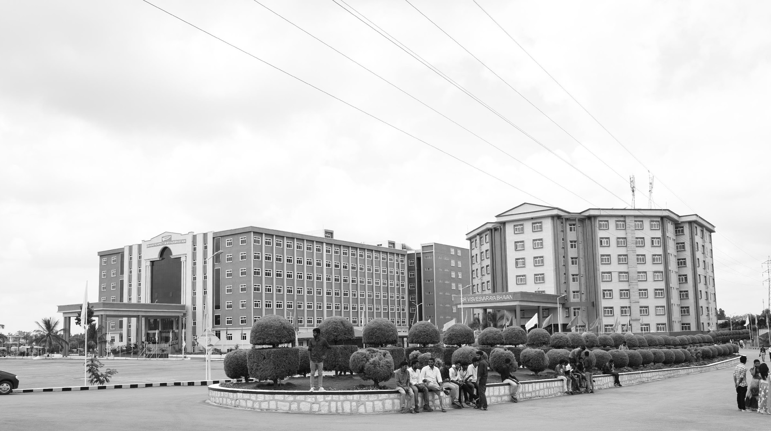

IoT based Smart Agriculture System
AY 2021-25
GITAM UNIVERSITY
Major Project
A University should be a place of light, of liberty, and of learning.
Department of Electrical Electronics and Communication Engineering
Project Team:
P. Vishnu Vardhan Reddy
Samarjeet Kumar
Ravindra Ganni
Project Mentor:
Dr. Subhashish Tiwari
EECE department
www.gitamedu.com

Slide 2

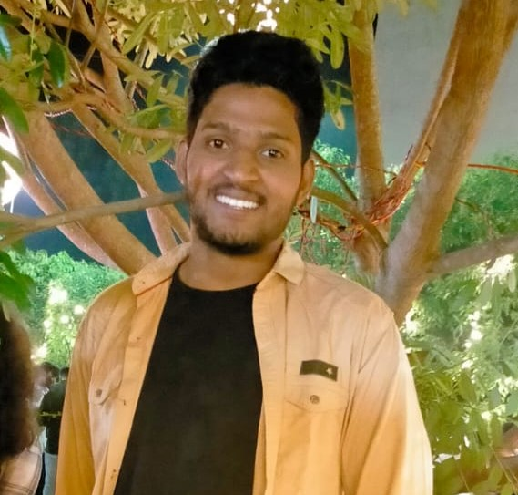


Project Group – Details
Photo
Track
Roll No
Name
Photo
EECE
BU21EECE0100446
P. Vishnu Vardhan Reddy
Photo
EECE
BU21EECE0100265
Samarjeet Kumar
Photo
EECE
BU21EECE0100495
Ravindra Ganni

Slide 3
Abstract
IoT is making agriculture smarter and more efficient. Smart farming is realized through the use of IoT technologies in enhancing farming practices through ways of automation and precise monitoring. IoT sensors are part of this change because they help in providing real-time information about agricultural fields critical in making informed decisions and efficient management of resources. The principal idea of using IoT in agriculture is increasing crop yield through proper monitoring of environmental factors.
The continuous flow of data from IoT sensors provides farmers with real-time insights into the conditions of their fields. This real-time information is crucial for making informed decisions on critical aspects like irrigation scheduling, fertilizer application, and pest control. By using this data, farmers can intervene precisely when needed, reducing resource wastage and ensuring that crops are nurtured in the best possible environment. This leads to healthier crops and improved productivity.
The integration of imaging technologies with IoT devices, such as those interfaced with the CC3200 chip, adds another layer of sophistication to smart agriculture. For instance, cameras connected to IoT systems can capture images of the agricultural field and transmit them to the farmer's mobile phone via Wi-Fi. This real-time visual monitoring allows farmers to remotely inspect their fields, detect potential issues like pest infestations or disease outbreaks, and take timely remedial actions. This proactive approach helps in maintaining crop health and avoiding significant losses.
IoT technology is at the forefront of promoting precision farming, where the focus is on optimizing resource use and minimizing waste. By providing farmers with detailed and accurate information about their crops and fields, IoT systems like the CC3200 chip enable more sustainable farming practices. This not only helps in achieving better yields but also contributes to the long-term sustainability of agriculture by ensuring that resources are used efficiently and that environmental impact is minimized.

Slide 4
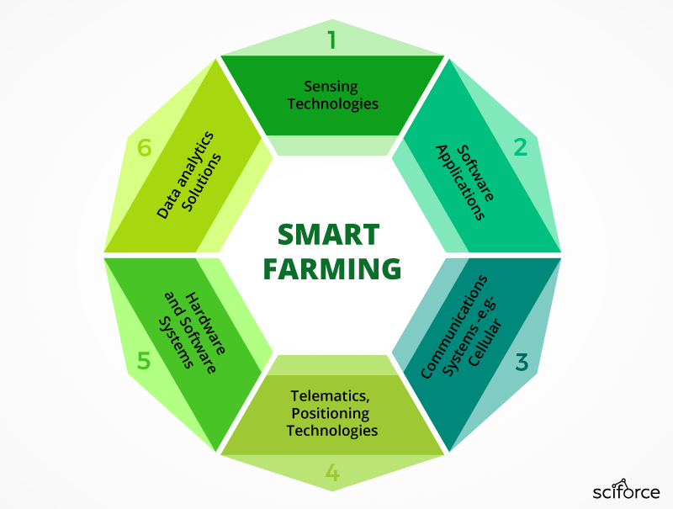
Objective and Goals
Objective
The objective of an IoT-based smart agriculture system is to design and implement a technology-driven framework that utilizes IoT devices and sensors to monitor and manage agricultural processes in real-time. The system aims to optimize resource usage, enhance crop productivity, and improve decision-making by providing farmers with accurate, real-time data on critical environmental parameters such as temperature, humidity, soil moisture, and light intensity. By integrating automation, remote monitoring, and data analytics, the project seeks to achieve precision farming, reduce resource wastage, and promote sustainable agricultural practices, ultimately leading to higher crop yields and improved farm management efficiency.
Goals
Main Goals
Optimize Resource Utilization
Enhance Crop Productivity
Real-time Monitoring
Reduce Environmental Impact
Increase Farm Profitability

Slide 5
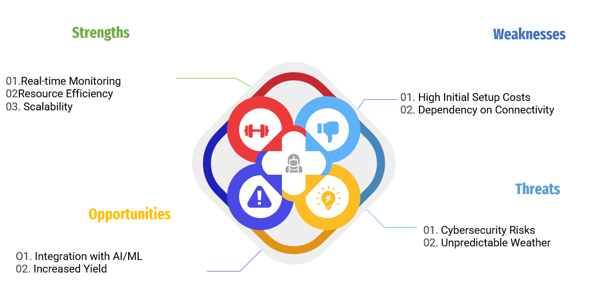
Analysis - SWOT

Slide 6
Literature Survey
Study/Author(s) | Year | Focus/Objective | Technologies Used | Key Findings/Contributions
Kumar, A. et al. | 2023 | IoT, Cloud Computing, Sensors | Arduino, soil moisture sensors, Wi-Fi | Real-time monitoring of soil moisture, temperature, and humidity using IoT devices, predictive analytics for irrigation management
M. Kumar and R. Kaur | 2018 | Precision agriculture using IoT | Raspberry Pi, DHT11, soil sensors | Developed a system for real-time monitoring of temperature, humidity, and soil moisture, leading to better crop management.
Shaikh Sayeeda Gulab | 2023 | IoT-based greenhouse monitoring | Wireless sensor networks, ZigBee | Enabled remote monitoring and control of greenhouse conditions, improving crop health and reducing energy consumption.
Singh & Gupta | 2022 | "Classification and Yield Prediction in Smart Agriculture System using IoT" | IoT, Machine Learning (ML), Drone Tech | Use of IoT and drones for smart irrigation, pest detection, and automated crop monitoring using machine learning algorithms

Slide 7
Literature Survey
Study/Author(s) | Year | Focus/Objective | Technologies Used | Key Findings/Contributions
Patel, N., & Patel, A. | 2021 | IoT framework for smart farming | IoT sensors, LoRaWAN, Cloud platform | Developed a system that monitors soil moisture and environmental conditions using low-power IoT devices.
Zhang, X., et al. | 2020 | Precision farming using IoT and AI | IoT, Machine Learning, Cloud computing | The study highlights AI-driven crop monitoring and the role of IoT in optimizing resource use in agriculture.
Dhivya, R., & Saravanakumar, D. | 2019 | Remote crop monitoring and automation | Wireless sensor networks, Arduino, GSM | Proposed an automated irrigation system to control water usage, reducing wastage and improving crop health.
Khanna, A., & Kaur, S. | 2020 | IoT-based crop yield prediction | IoT, Big Data, Neural Networks | Emphasized the use of IoT data for crop yield prediction models, with improvements in accuracy.

Slide 8
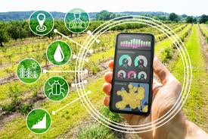
Introduction to Smart Farming:
Smart farming, also known as precision agriculture, represents the integration of advanced technologies into agricultural practices to increase efficiency, productivity, and sustainability. It leverages data-driven techniques to optimize every aspect of farming, from planting and irrigation to harvesting and livestock management.
Sensors and connected devices monitor soil conditions, weather patterns, crop health, and livestock behavior in real-time. This data is used to make informed decisions about planting, watering, and harvesting.
Drones equipped with cameras and sensors provide detailed aerial views of farmland. They help in monitoring crop health, identifying areas needing attention, and even in planting seeds in large areas.
Global Positioning Systems (GPS) and Geographic Information Systems (GIS) allow farmers to create detailed maps of their fields, track machinery, and apply inputs like fertilizers and pesticides with precision, reducing waste.

Slide 9
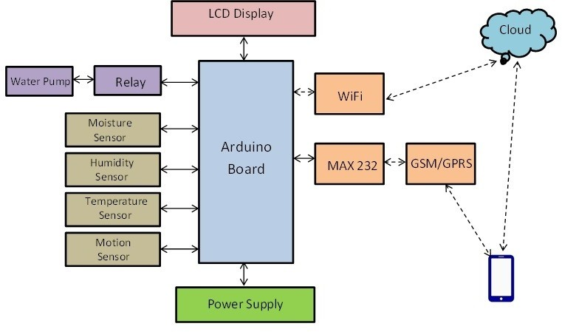
Block diagram

Slide 10
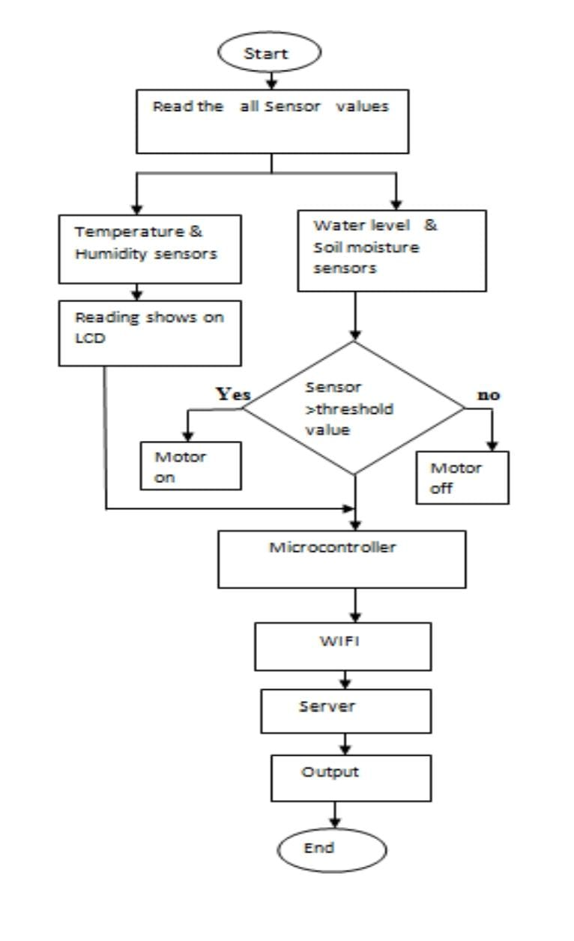
Implementation (Work Flow):

Slide 11
Software and Hardware components required:
Hardware components Required:
Arduino Board:
Sensors:
Soil Moisture sensor:
Temperature Sensor:
An Arduino board is a popular open-source microcontroller platform used for building electronic projects. It consists of a physical programmable circuit board (microcontroller) and Integrated development environment (IDE) that allows you to write and upload code to the board. Arduino boards are widely used for prototyping and educational purposes because they are easy to use, have a large community, and support various sensors and actuators, making them ideal for IoT applications, including smart agriculture systems.
The Soil Moisture Sensor uses capacitance to measure dielectric permittivity of the surrounding medium. In soil, dielectric permittivity is a function of the water content. The sensor creates a voltage proportional to the dielectric permittivity, and therefore the water content of the soil.
A temperature sensor is a device that is designed to measure the degree of hotness or coolness in an object. The working of a temperature meter depends upon the voltage across the diode. The temperature change is directly proportional to the diode's resistance.

Slide 12
Motion Sensor:
Relay:
LCD Display:
A motion sensor, or motion detector, is an electronic device that uses a sensor to detect nearby people or objects. Motion sensors are an important component of any security system. When a sensor detects motion, it will send an alert to your security system, and with newer systems, right to your mobile.
Relay is an electrical switch that allows devices to use low-power signals to control high-power circuits. It works similarly to a light switch, which closes an electrical circuit to turn on a light and opens it to turn it off. A relay performs the same function, but a low-power signal from an IoT device controls the switch.
The Serial Monitor is an essential tool when creating projects with Arduino. It can be used as a debugging tool, testing out concepts or to communicate directly with the Arduino board.

Slide 13
A power supply unit is used to provide stable electricity. The device converts and supplies electricity of the required voltage and frequency, excluding noise from the electricity obtained from an electrical outlet.
General packet radio service (GPRS) is essentially a packet-switching technology that allows information to be transmitted via mobile networks. This is utilized for internet connectivity, multimedia messaging service, and other types of data transmission.
The Arduino IDE Software (Integrated Development Environment) makes it easy to write code and upload it to the board offline. We recommend it for users with poor or no internet connection. This software can be used with any Arduino board. There are currently two versions of the Arduino IDE, one is the IDE 1.
Power Supply:
GPRS:
Arduino IDE:
Software components:

Slide 14
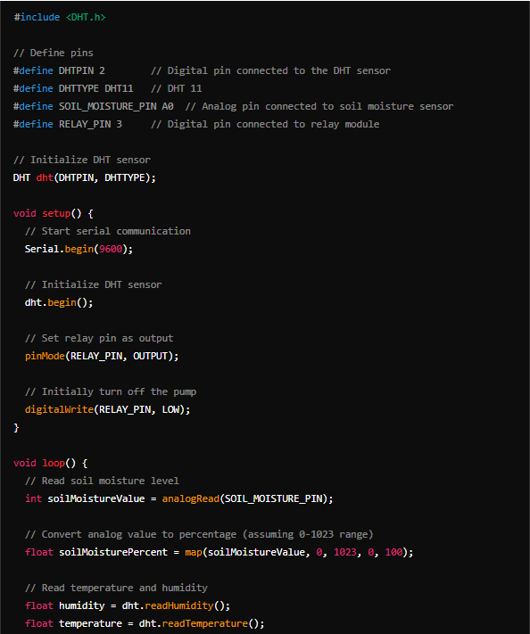
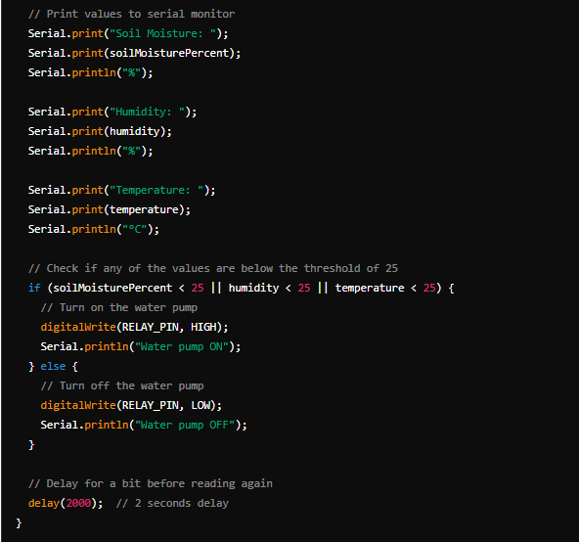
Code:

Slide 15
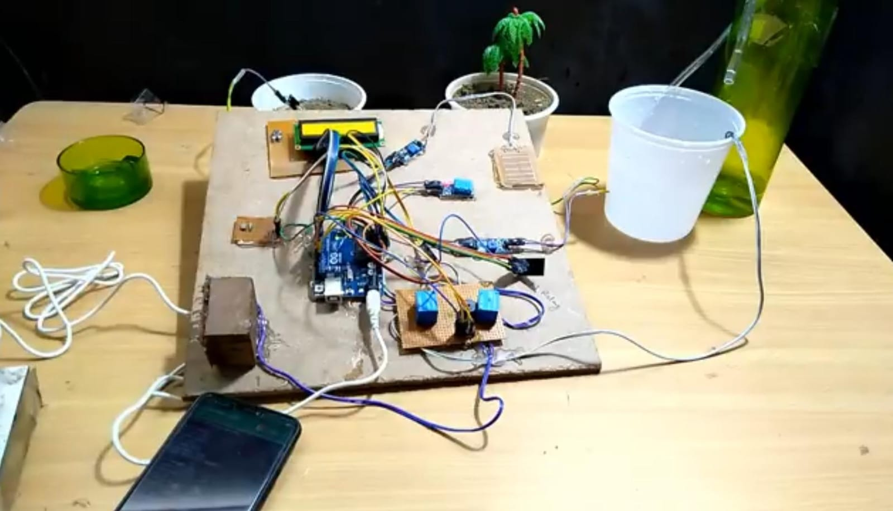
Results:

Slide 16
The image shows a DIY project setup, involving an automated plant irrigation system based on an Arduino microcontroller. Here’s a detailed explanation of the components and their probable functions:
Arduino Uno (Blue Circuit Board):
The central component of the system, this microcontroller is responsible for processing input from sensors and sending commands to other components like the water pump.
Soil Moisture Sensors:
The probes in the plant pots measure the soil moisture levels. The data is sent to the Arduino, which determines whether the soil is dry and needs watering.
LCD Display:
This yellow-green screen provides a visual output, possibly showing real-time data such as soil moisture levels, system status, or water pump activity.
Relay Module (Bottom Section with Blue Components):
This module acts as a switch for controlling higher voltage devices like water pumps. It allows the Arduino to turn the pump on and off when needed, based on the sensor readings.

Slide 17
Watering System:
The clear plastic cup and green bottle with tubing suggest a water storage system connected to a small pump. Water flows through the tube to the plants when the Arduino activates the pump, providing automated irrigation.
Power Supply (Phone Charger):
The system is powered via an external USB or phone charger, supplying electricity to the Arduino and the connected components.
Other Sensors or Components:
There are additional modules and wires, which could include sensors for detecting temperature, humidity, or light levels, contributing to a more advanced control system.
In summary, this project automates plant watering using a microcontroller and sensors, ensuring that the plants are watered only when the soil moisture drops below a certain level. It’s likely designed to be efficient and prevent overwatering, making it ideal for home gardening or agricultural purposes.

Slide 18
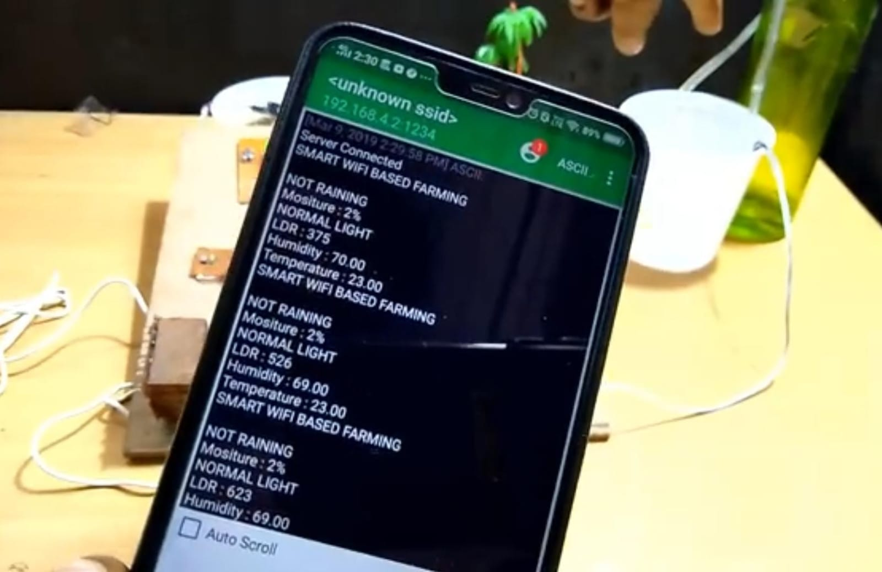
Readings:

Slide 19
This image shows a smartphone displaying data from a smart farming system. It seems to be an interface connected to the Arduino-based automated irrigation system shown earlier, possibly via a Wi-Fi module. Here's an analysis of the key aspects:
Wi-Fi-Based Smart Farming System:
The header on the screen says “SMART WIFI BASED FARMING,” indicating that this system can be monitored or controlled remotely through a Wi-Fi network.
Sensor Data:
The phone screen displays real-time data from the sensors connected to the system, including:
Moisture Level: Currently showing low soil moisture at 2%.
Light Levels (LDR): This is a reading from a light-dependent resistor (LDR) sensor measuring ambient light.
Humidity: The humidity in the environment is displayed at around 69-70%.
Temperature: The ambient temperature is reported as 23°C.

Slide 20
Status Messages:
The system is showing the message "NOT RAINING", which could indicate there is no rainfall detected, potentially from a rain sensor.
It provides information on whether the system is operating normally or if it needs to activate based on the data.
Server Connected:
The message at the top of the screen confirms that the phone is connected to a server through the IP address shown, possibly hosting the data from the system.
In conclusion, this setup uses a Wi-Fi module to allow remote monitoring of the farming system, making it easy for the user to observe key environmental data like soil moisture, light, humidity, and temperature. This enhances the efficiency of the irrigation system by responding to real-time conditions.

Slide 21
References:
T. M. Fernandez, A. Rajesh, “Smart Irrigation System using IoT,” International Research Journal of Engineering and Technology (IRJET), 2019 – A paper explaining smart irrigation using IoT for real-time monitoring and automation.
Y. K. Meena, "IoT Based Automatic Irrigation System," International Journal of Scientific & Technology Research (IJSTR), 2019 – Discusses the implementation of IoT for automatic irrigation using sensor networks.
K. A. Patel, A. S. Agrawal, “IoT based Smart Agriculture System,” International Journal of Computer Applications (IJCA), 2018 – Focuses on precision farming and environmental monitoring using IoT.
R. Gutiérrez et al., “Automated Irrigation System Using a Wireless Sensor Network and GPRS Module,” IEEE Transactions on Instrumentation and Measurement, 2014 – Discusses the application of wireless sensor networks for automated irrigation in agriculture.
M. Saraf, P. Gawali, “IoT Based Smart Irrigation Monitoring and Controlling System,” International Journal of Computer Applications (IJCA), 2017 – Describes an IoT-based system for monitoring and controlling irrigation remotely using sensors.

Slide 22
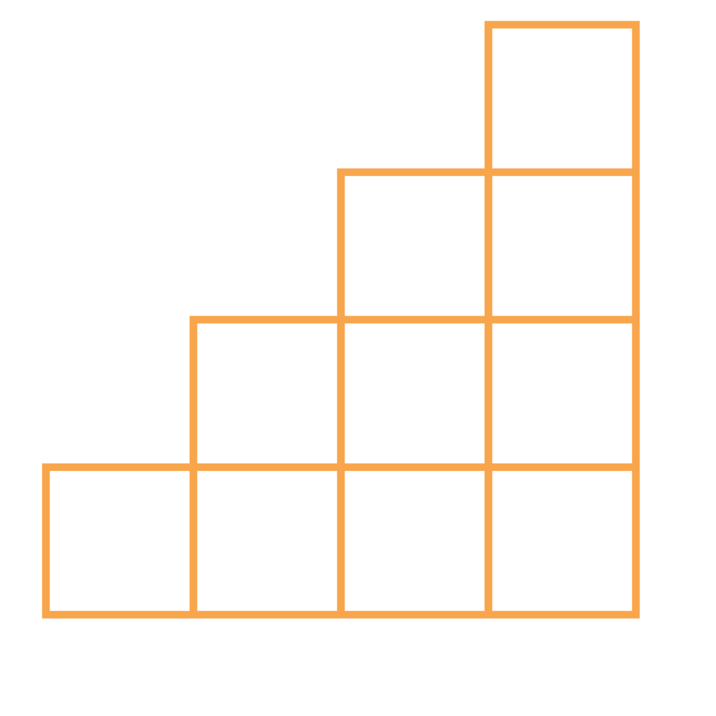
THANK YOU

